Slide 1
Damage Control Resuscitation: for Abdominal and Pelvic Injury
Centre for Trauma Sciences

Slide 2
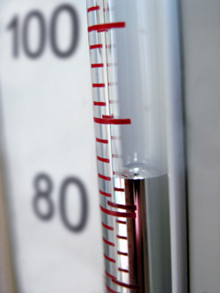
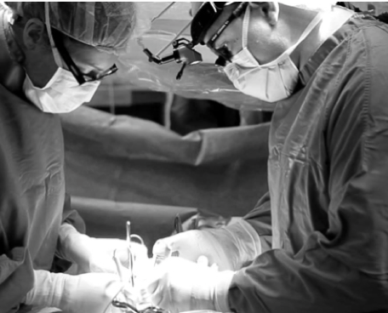
Clarke et al., The Journal of trauma. 2002;52(3):420-5
20 Years
Harvin et al., The Journal of trauma. 2017;83(3):464-8
40%
46%
Notes:
This work was stimulated by two publications from American Civilian trauma centres examining the outcomes of hypotensive trauma patients. (CLICK)
In the first paper a cohort of patients going back Twenty years looked at the outcomes of nearly 250 hypotensive trauma patients in Pennsylvania. All of these patients were hypotensive on arrival in the Emergency Department and had a laparotomy. (CLICK) Their mortality was 40%. They recognised that mortality was increasing the longer the patient remained in the ED up to a cut off of 90 minutes.
In another study published last month Harvin and Colleagues at 12 American Level 1 Trauma Centres, nearly 400 hypotensive patients undergoing a trauma laparotomy within 90 minutes of arrival had a mortality rate of 46%.

Slide 3
No improvement over time
Royal London Hospital
Camp Bastion

Slide 4
Improved Prehospital Care
Damage Control Resuscitation
Revolutionised Transfusion
Decreased hypothermia
Improved Training
Tranexamic Acid
Diagnostic Capabilities
Notes:
And this high and seemingly unchanged mortality rate is particularly hard to swallow for many trauma clinicians who perceive the overall outcomes have improved considerably as a result of host of perceived improvements to trauma care that include (CLICK) better prehospital care, damage control resuscitation techniques and revolutionised transfusion support.
And the list goes on and on …

Slide 5
Time to Death in hypotensive laparotomy patients
Surviving fraction
Hours to death

Slide 6
Why?
Hypotensive patients requiring laparotomy have poor outcomes:
Clarke (2002) – 40% mortality
Harvin (2017) - 46% mortality
Marsden (2018) - 47% mortality
TARN captures some data, but not enough
Are we achieving physiological resuscitation?
What are the intra-operative procedures?
Who is going to IR?

Slide 7
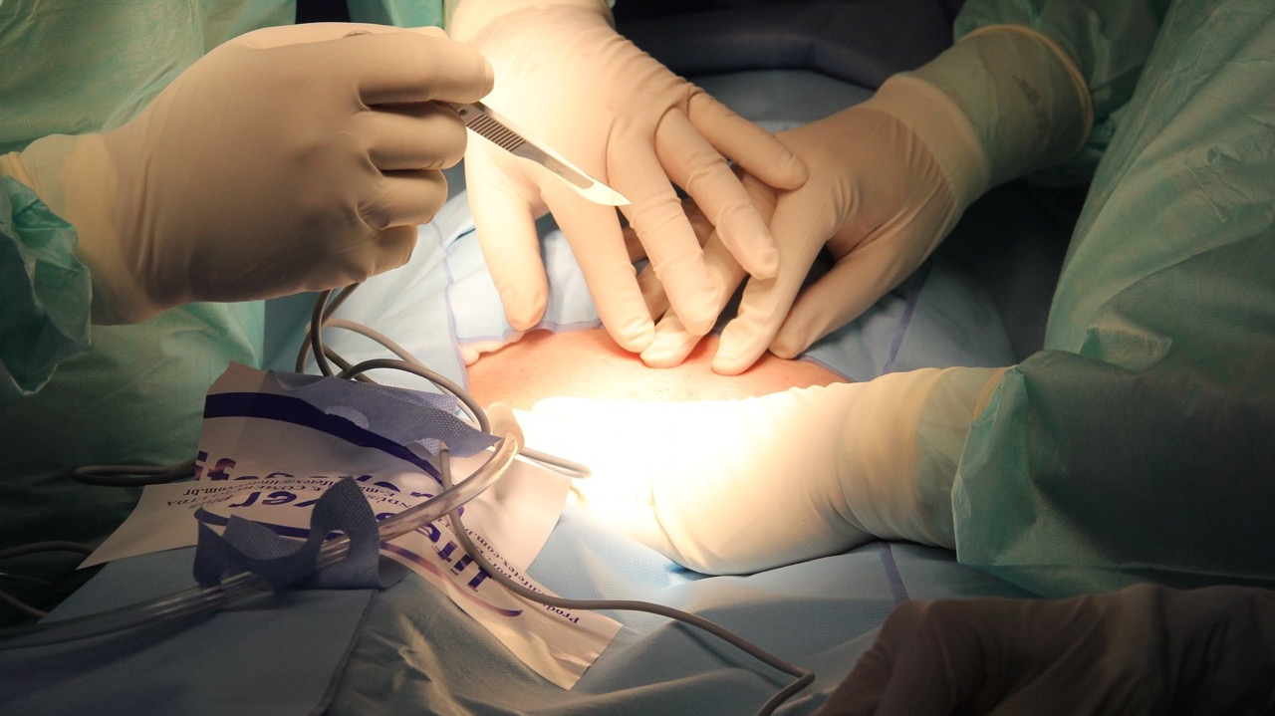
Aims
Are we truly practicing damage control resuscitation?
Who, why and when do these patients die?

Slide 8
How?
Multi-centre (preferably all MTCs/TUs)
Prospective observational study data capture for 6 months
Physiological data from ED, OR, ITU
Intra-operative procedures
Immediate transfusion requirements
Timing of second-look additional procedures
Cause of death in first 2 weeks
Collect mortality/most demographics from TARN

Slide 9
So What?
Provide a contemporary narrative of the management of abdominal/pelvic injury with associated haemorrhage
We need to know where we are failing to drive improvements in care

