Slide 1
Clinical Governance, Commissioning and Major Trauma. What does it mean for YOU?
Natalie Marroney and Davina Richardson

Slide 2
Aims:
To introduce some of the processes and practices that support the delivery of trauma services
To explore and discuss developments in the governance and data collection and what it means for clinicians

Slide 3
What does clinical governance mean to trauma services?

Slide 4
Clinical Governance
A system through which NHS organisations are accountable for continuously improving the quality of their services and safeguarding high standards of care by creating an environment in which excellence in clinical care will flourish

Slide 5
4 pillars of clinical governance
Quality Improvement
Patient focus
Leadership
Staff focus
Notes:
How does this relate specifically to Major Trauma?
What do we do to ensure clinical governance?

Slide 6
Audit
Trauma Audit and Research Network?

Slide 7
What is TARN?
1. Underpins clinical audit for traumatic injuries across the country, by collecting and comparing performance and outcomes. It provides statistically robust data that can be used to drive up standards of care.
2. The database which has been accumulated for more than 30 years is the largest trauma data base in Europe. This provides an excellent platform for trauma research locally, nationally and internationally.
Statistical robustness:
using TARN data to update and improve case mix adjustment - so that we can benchmark Trust and Trauma Network performance
Trauma systems:
We use these data to identify effective systems of trauma care
Epidemiology:
We provide a publicly accessible database that can contribute to the epidemiology of major trauma
Special projects:
We undertake research projects internally, in collaboration with those who supply TARN with patient data and with external agencies

Slide 8
What is TARN?
Statistics can be a powerful replacement for clinical anecdote in the drive to provide evidence base for the development of effective trauma care systems.
TARN
Operational Performance
Quality Improvement
Patient Safety

Slide 9
What is TARN?
Clinical Reports
Customised analysis
Trauma Research
Comparative Quarterly reports
Regional or Specialist unit comparison

Slide 10
TARN
How does this fit in with governance?
How do we utilise TARN?

Slide 11
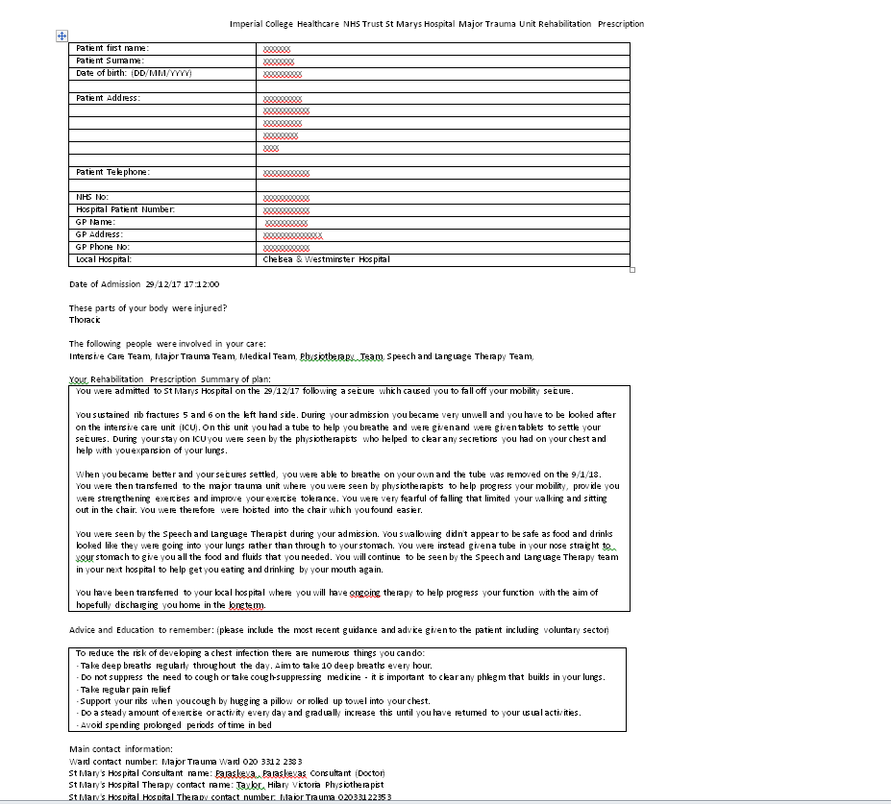
Rehab Prescriptions
Notes:
Data collection

Slide 12
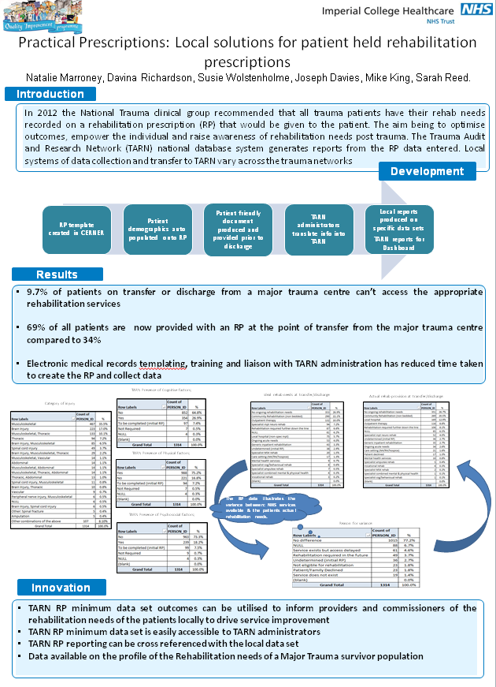
How could you utilise data locally?

Slide 13
Commissioning
What does commissioning mean to you?

Slide 14
Commissioning is the continual process of planning, agreeing and monitoring services. Commissioning is not one action but many, ranging from the health-needs assessment for a population, through the clinically based design of patient pathways, to service specification and contract negotiation or procurement, with continuous quality assessment.

Slide 15
What is Best Practice Tariff?
A set of prices and rules to help providers of NHS care and commissioners provide best value and care to their patients

Slide 16
Case Study- Patient A
Moped vs pole
  Bilateral large haemothoraces
  Right shallow apical pneumothorax
  Right posterior rib fractures 10th and 11th
  T5 to L4 spinous process fractures
  T12 Comminuted 3 coloumn fractures with cord involvement
  Splenic laceration

Slide 17
Pathway and Timeline
07/09/18: Brought into hospital with LAS
07/09/18: Admitted to Watford General Hospital
08/09/18: Transferred to St Marys Hospital
08/09/18: T11-L1 posterior surgical fixation
09/09/18: Admitted to ITU
10/09/18: ASIA completed- L2 ASIA D
10/09/18: Referral completed to Stoke Mandaville
12/09/18: Step down to Major trauma ward
14/09/18: Repatriation form completed to Wrexham park hospital

Slide 18
Patient pathway
London Ambulance Service
A and E at local trauma unit
Transfer to Major Trauma Centre
Intensive Care Unit
Major Trauma Ward
Repatriation to local hospital
Rehabilitation
At specialist spinal cord injury unit
Notes:
Ambulance services in London are currently commissioned locally with Brent CCG acting as lead commissioner for 32 groups across the city
MT is specialist commissioning- not for trauma units
Adult critical care services are jointly commissioned by both NHS England and by Clinical Commissioning Groups (CCGs).
SCI rehab specialist commissioning by NHS England

Slide 19
What has influenced this patient’s pathway?
LAS triage
Severity of injury
Patient’s home address and GP
Rehab needs
Bed pressures
Waiting times

Slide 20
Commissioning and implications for staff
Why is commissioning important for us to be aware of?
How does it impact our decision making?
What can we do to influence commissioning?

Slide 21
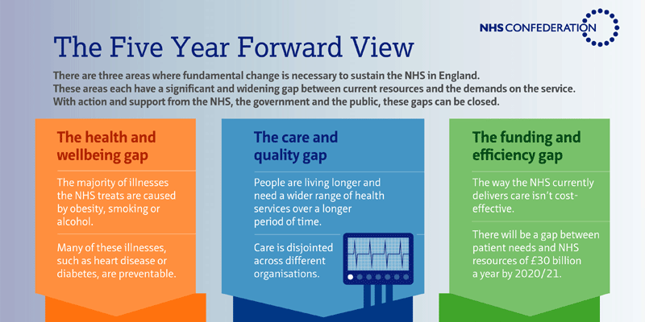
Commissioning:
Five year forward plan
The future sustainability of the NHS depends on a radical upgrade in prevention and public health.
It commits to giving patients more control of their own care, including the option of combining health and social care, and new support for carers and volunteers.
New models of care that break down the boundaries between traditional healthcare settings, physical and mental health, and health and social care.
It sets out the actions needed to “develop and deliver” the new models of care, such as providing local flexibility in the way that payment, rules and regulatory requirements are applied – plus more investment in workforce, technology and innovation.

Slide 22




How are the NHS and local authorities integrating care?
2014 – NHS set out new vision (NHS Five Year Forward View) saying break down barriers between GPs and hospitals, physical and mental health, social care and the NHS
2015 – NHS started piloting five new models in 50 areas across England known as ‘vanguards‘ – local provider partnerships
2016 – NHS sets up 44 sustainability and transformation partnerships (STPs) to plan care across geographies, covering all of England
2017 - NHS promised to evolve STPs into Integrated Care Systems (ICSs) that would take on more responsibility and have more freedom
“The biggest national move to integrating care of any major western country”
2015

Slide 23
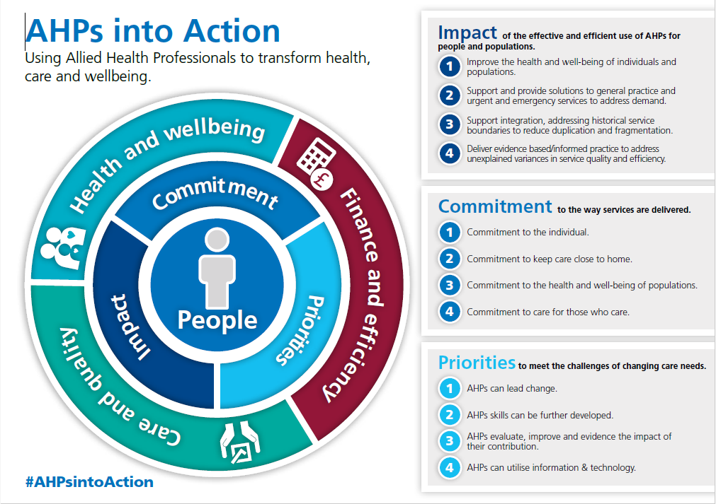
Notes:
AHPs into Action is a national framework and programme of work focusing on the role of Allied Health Professionals (AHPs) in transforming health, care and wellbeing.

Slide 24
Further reading
Sustainability and Transformation Partnerships Progress Dashboard:
https://www.england.nhs.uk/publication/sustainability-and-transformation-partnerships-progress-dashboard-baseline-view/
NHS 5 year forward view:
https://www.england.nhs.uk/wp-content/uploads/2014/10/5yfv-web.pdf
TARN website:
https://www.tarn.ac.uk/
NHS commissioning:
https://www.england.nhs.uk/commissioning/what-is-commissioning/
AHPs into action:
https://www.england.nhs.uk/wp-content/uploads/2017/01/ahp-action-transform-hlth.pdf

Slide 25
References
Chalkley,D.Cheung,G.Walsh,&M.Tai,N. (2011). Deaths from trauma in London a single centre experience. Emergency Medicine Journal,28 ,pp.305-309. doi:10.1136/emj.2009.085613
Darzi of Denham KBE. (30 June 2008). High quality care for all: NHS Next Stage Review final report. Retrieved from http://www.dh.gov.uk/en/Publicationsandstatistics/Publications/PublicationsPolicyAndGuidance/DH_085825
Data Collection and reporting for the major trauma best practice tariff: Support document for data coordinators at major trauma centres, 2012. Retrieved 27, November, 2012 fromhttp://www.tarn.ac.uk/content/downloads/53/Support%20Document%20for%20the%20Best%20Practice%20Tariff-TARN%20Coordinators.pdf
National Audit Office (2010). Major Trauma care in England. London: The Stationery Office.
NHS England (2014). Five year forward view.
NCEPOD.(2007). Trauma:Who cares?A report of the National Confidential Enquiry into Patient Outcome and Death(2007).London: NCEPOD
NHS choices. Retrieved 27,Nov,2012 from:http://www.nhs.uk/NHSEngland/AboutNHSservices/Emergencyandurgentcareservices/Pages/Majortraumaservices.aspx
Regional Networks for Major Trauma NHS clinical advisory groups report, (2010).Retrieved 13, May, 2012 from:http://www.excellence.eastmidlands.nhs.uk/welcome/improving-care/emergency-urgent-care/major-trauma/nhs-clinical-advisory-group/
Ann Surg. 2016 Jul;264(1):188-94. doi: 10.1097/SLA.0000000000001393. The Impact of a Pan-regional Inclusive Trauma System on Quality of Care. Cole E¹, Lecky F, West A, Smith N, Brohi K, Davenport R
TARN Procedures Manual 2016

