Slide 1
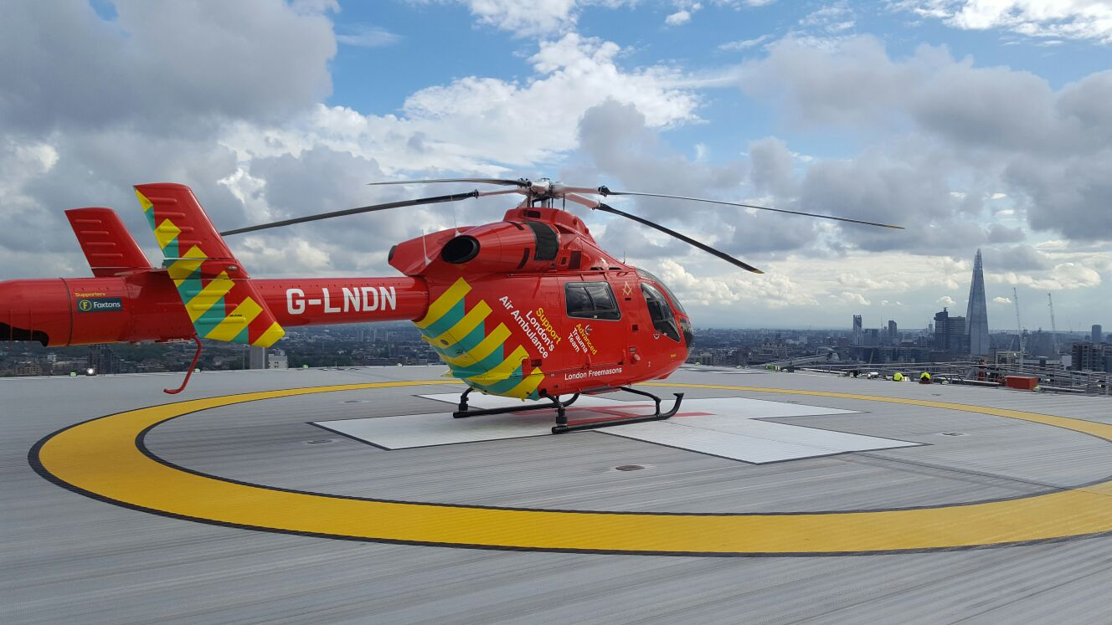

MAJOR TRAUMA Rehabilitation
TRAINING
Dates:
April 21st 2021
May 18th 2021
June 17th 2021
Price: £35
Hosted virtually on www.londontraumaschool.com
The study days are to enable development of those professionals working in / or with an interest in working in the Major Trauma system, so that they may be able to enhance or seek emerging roles in this field.
The study days are run in collaboration with the pan London Major Trauma System (www.londontraumasystem.org) and sessions are delivered by many trauma experts within the system.
Day 1 - The development of trauma systems, networks and national audits. Management of poly trauma
Day 2 - Psychological Implications of trauma rehabilitation and the physiology of healing following major trauma
Day 3 - After trauma recovery and return to meaningful activity
For more information OR TO Preliminary book a place.
Please Contact:
Natalie marroney
Natalie.marroney@nhs.net

